Slide 1

Computer Vision

Slide 2
Computer Vision
-it seeks to automate tasks that the human visual system can do.
-how computers can be made for gaining high-level understanding from digital images or videos
Image data can be of the form:
video sequences, views from multiple cameras, or multi-dimensional data from a medical scanner

Slide 3
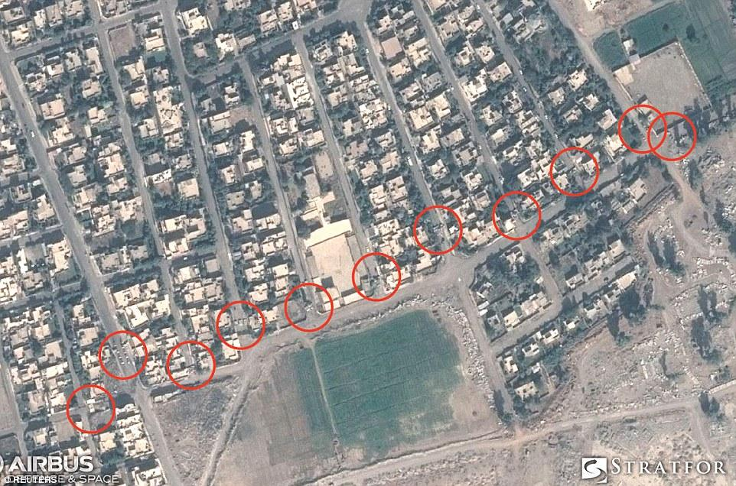
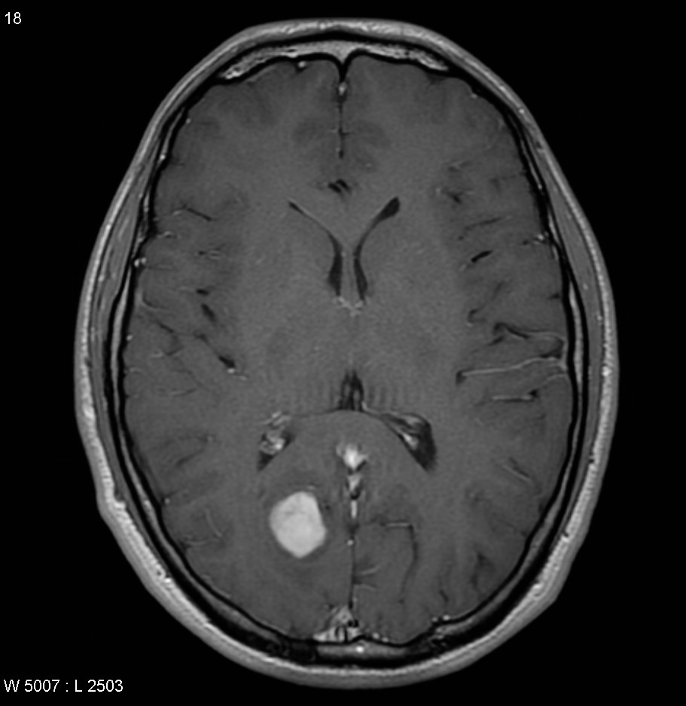
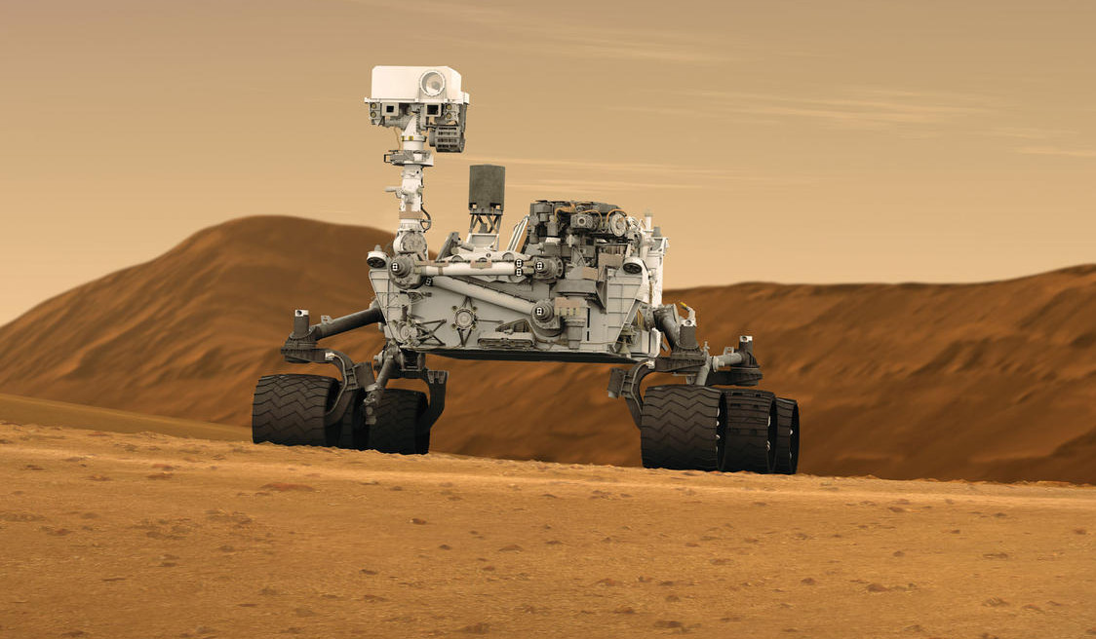
Applications:
Self driving cars, Face recognition, Gesture recognition, Optical Character recognition, e.t.c
Scanning terrorists bases
Analysing tumors
Mars Exploration Rovers

Slide 4
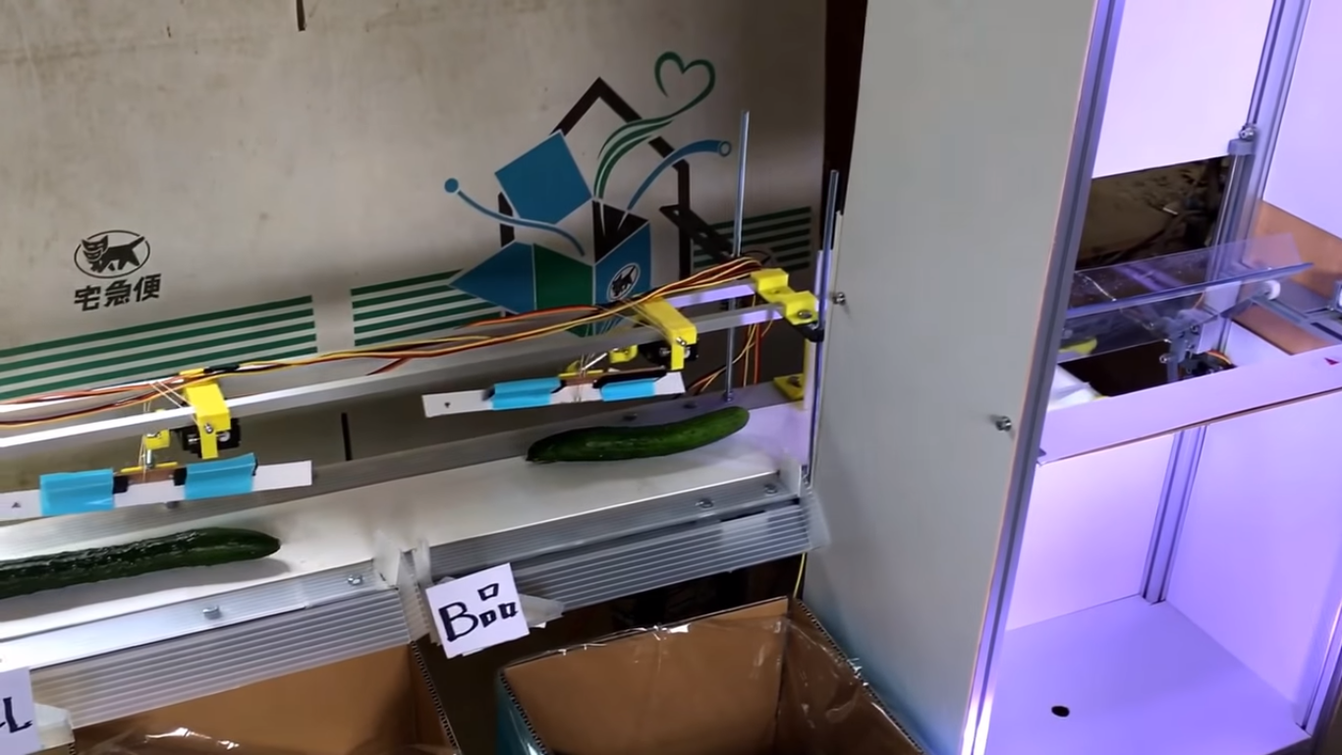
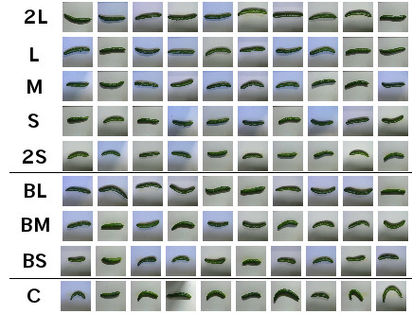
Small Scale Application:
-Makoto Koike
-Small Farmer in Japan
-To differentiate various sizes of cucumber
Machinery built
Various Pictures

Slide 5



Slide 6



Collections of all the Text
Collection of millions of images
Image classifier
Trained on all those images

Slide 7
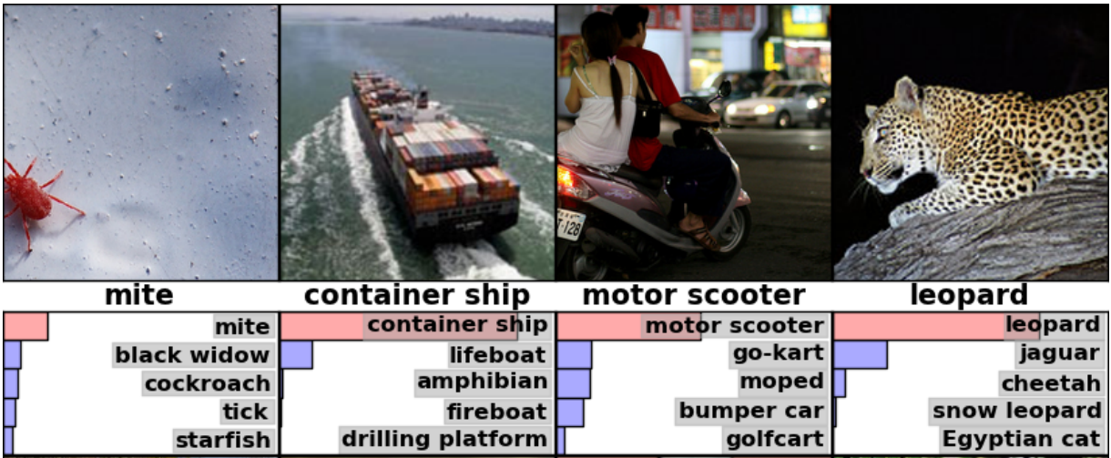
Top-5 error rate
Inception (GoogLeNet)
Inception-v3
Alex Net
BN-Inception-v2
15.3%
6.67%
4.9%
3.46%

Slide 8
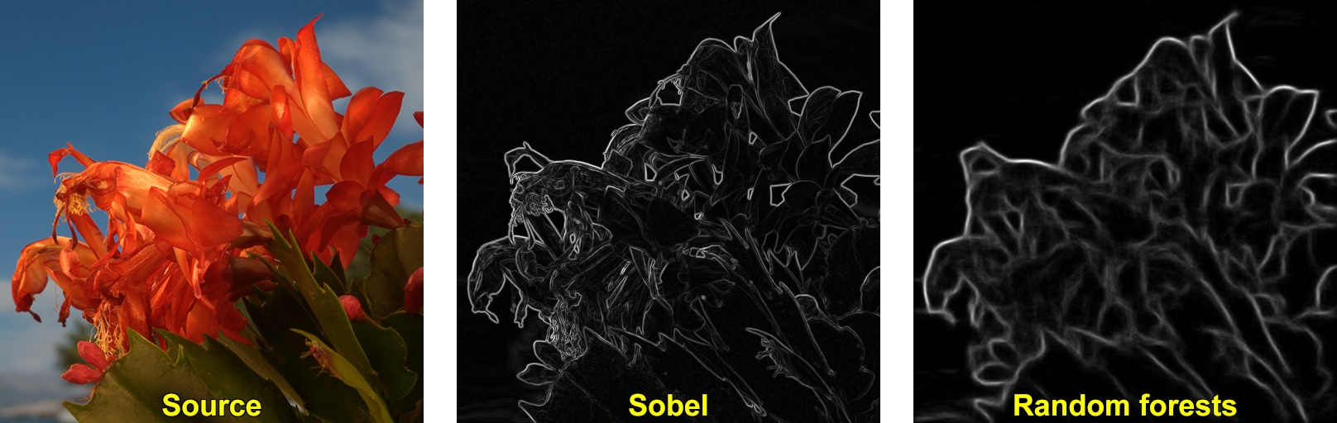
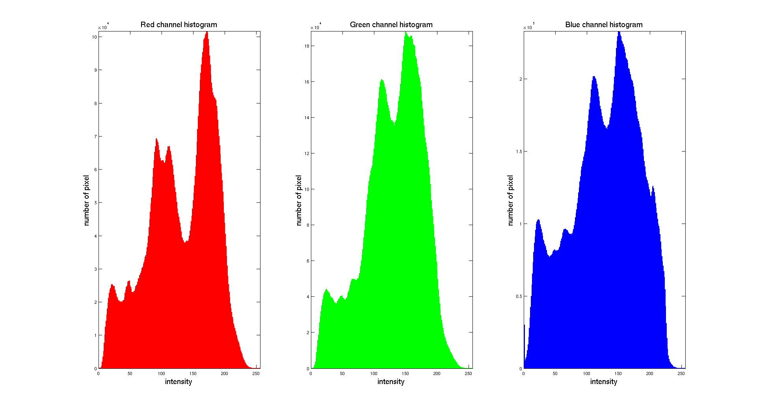
Edge-Detection
Color Histogram

Slide 9
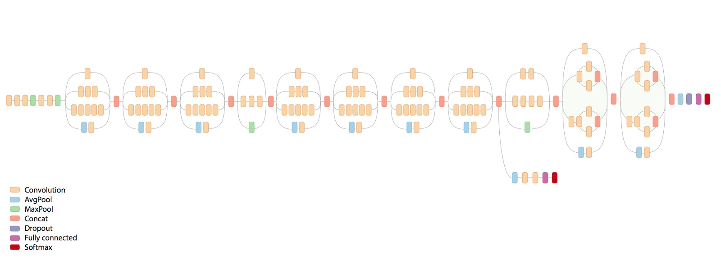
Inception:

Slide 10
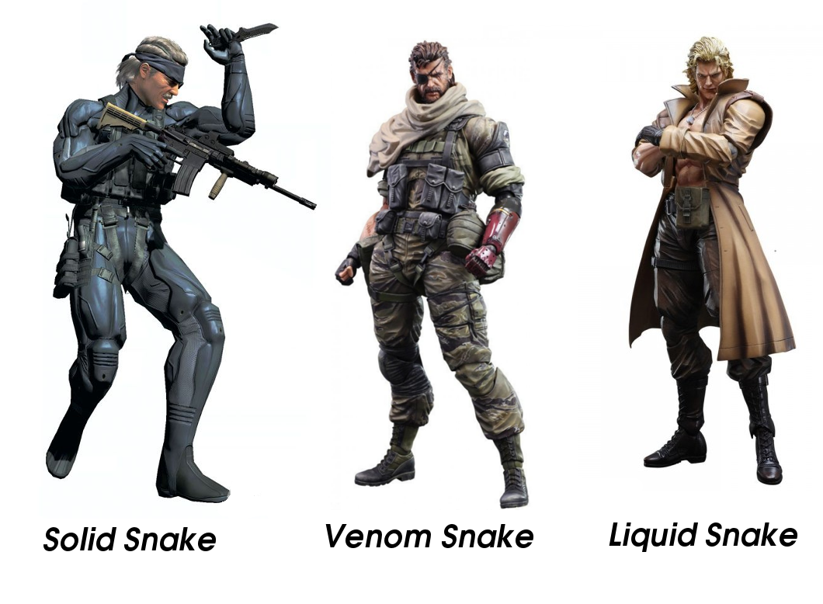

Pre-Existing Inception
Neural network
Retrain using my images
Classifying the final image

Slide 11
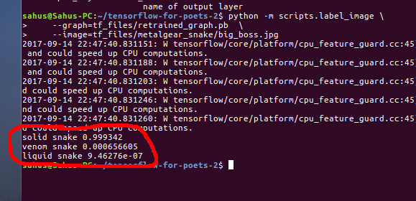

github.com/VSuhas22

